Slide 1
PROFILE BASED ROOM AUTOMATION USING AI
GROUP NO :- 5
MEMBERS:- ANIRUDDH PATIL NAMRATA JOSHI GARGI SURVE
GUIDE : -
PROF. APEKSHA MOHITE
CO-GUIDE:-
PROF. NAHIDKAUSAR SHAIKH

Slide 2
INTRODUCTION
◆ WHY
◆ To provide control over one’s environment
◆ To ease and improve living experience
◆ WHAT
◆ Automated Room Control System
◆ Intelligent User Based Profiling
◆ HOW
◆ Use of Android Things to control the IOT Experience
◆ Use of Tensorflow for Machine Learning

Slide 3
LITERATURE REVIEW
SR NO | Paper | Methodology | Advantages | Disadvantages
1 | Towards the Implementation of IoT for Environmental Condition Monitoring in Homes-Sean Dieter Tebje Kelly, Nagender Kumar Suryadevara, and Subhas Chandra Mukhopadhyay, Fellow, IEEE, IEEE SENSORS JOURNAL, VOL. 13, NO. 10, OCTOBER 2013 | ZigBee WSN Network using IPv6 Connectivity with packet Transmission and data storage with UDP packets | Moderate scalability, fault Tolerance low-cost solution and flexible connection greater control over routing of packets | IPv6 connectivity security issues for ZigBee Uncommon architecture
2 | Smart Home and Smart City Solutions enabled by 5G, IoT, AAI and CoT ServicesK E Skouby, P Lynggaard - 2014 International Conference on Contemporary Computing and Informatics (IC3I) | Four layer model which join and interfaces these elements by deploying technologies such as 5G, internet of things, cloud of things, and distributed artificial intelligence | ability to upgrade the smart homes and implement new service offered from cloud based repositories. benefits of centralizing all the big-data information on few cloud servers. | Technology isn’t availed at a consumer level

Slide 4
LITERATURE REVIEW
SR NO | Paper | Methodology | Advantages | Disadvantages
3 | Mobile based Home Automation using Internet of Things(IoT) Kumar Mandula, Ramu Parupalli, CH.A.S.Murty, E.Magesh, Rutul Lunagariya -2015 International Conference on Control,lnstrumentation, Communication and Computational Technologies (lCCICCT) | Home automation using Bluetooth and Ethernet using Arduino | Low energy consumption and easy connectivity | Lack of standards for integrating various sensors, applications and other existing intelligent embedded devices. Providing unique IP addresses for connected devices and privacy & security
4 | A Remote Sensor Network using Android Things and Cloud Computing for the Food Reserve Agency in Zambia - Mulima Chibuye, Jackson Phiri (IJACSA) International Journal of Advanced Computer Science and Applications, Vol. 8, No. 11, 2017 | Using Android things to enable IOT and cloud | Ease of interfacing and easy app integration

Slide 5
LITERATURE REVIEW
SR NO | Paper | Methodology | Advantages | Disadvantages
5 | Implementation of Voice Based Home Automation System Using Raspberry Pi - Harshada Rajput1, Karuna Sawant2, Dipika Shetty3, Punit Shukla4, Prof. Amit Chougule5 International Research Journal of Engineering and Technology (IRJET) e- ISSN: 2395-0056 Volume: 05 Issue: 05 | May-2018 | Voice Based Home Automation System using Raspberry Pi | Easy interaction with the system and increased comfort level | Authenticaton, accent recognition
6 | Intelligent smart home energy efficiency model using artificial TensorFlow engine Jo and Yoon Hum. Cent. Comput. Inf. Sci. (2018) 8:9 | Use of Tensorflow to optimize the use of energy consumption | Better result with least interaction,smart decision | Developing correct model can be difficult

Slide 6
LITERATURE REVIEW
SR NO | Paper | Methodology | Advantages | Disadvantages
7 | IoT Based Home Automation System over the Cloud Ms. Fareha Firdous, Ms. Sumayya, Mr. Aseem Mohd Umair International Journal of Innovations & Advancement in Computer Science IJIACS ISSN 2347 – 8616 Volume 7, Issue 3 March 2018 | Home automation using private cloud and mobile app | Reduced installation costs: System scalability and easy extension Integration of mobile devices | No voice support
8 | IoT based Smart Home Automation System using Sensor Node Himanshu Singh , Vishal Pallagani†, Vedant Khandelwal‡ and Venkanna U.§ 4th Int’l Conf. on Recent Advances in Information Technology | RAIT-2018 | | Sensor Network using microcontroller to sense data | Can be integration with other technologies easily | Lacks intelligence

Slide 7
LITERATURE REVIEW
SR NO | Paper | Methodology | Advantages | Disadvantages
9 | Smart Gesture Control for Home Automation Using Internet of Things Sunil Kumar Khatri, Govind Sharma, Prashant Johri and Sachit Mohan © Springer Nature Singapore Pte Ltd. 2018 S. Bhalla et al. (eds.), Intelligent Computing and Information and Communication, Advances in Intelligent Systems and Computing 673, | Using gesture to control appliances | Gives the ability to improve user interaction and ease of action | Complex algorithms and high resource rerequirements
10 | Smart Home Automation System Using Bluetooth Technology Muhammad Asadullah, IEEE Student Member, Khalil Ullah 978-1-5090-3310-2/ 17/$3\.00 ©2017 IEEE | Using Bluetooth for consumption | Easy compatibility , low energy | Low range, low data transfer rates

Slide 8
PROBLEM STATEMENT
◆ Wastage of resources
◆ Unoptimized power consumption.
◆ No absolute control over our environment.
◆ Low comfort of living
◆ Automated Room Control System
◆ Intelligent User Based Profiling

Slide 9
PROJECT SCOPE
◆ Smart Homes / Buildings
◆ Smart Classroom / Lab
◆ Smart Cities

Slide 10
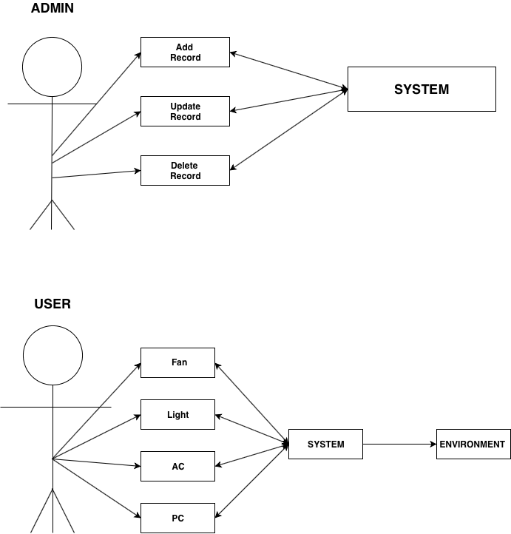
USE CASE

Slide 11
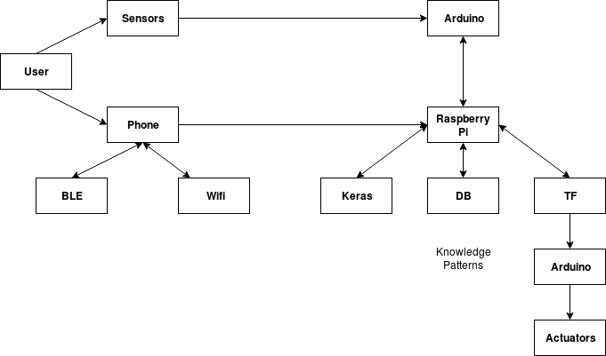
ARCHITECTURE

Slide 12
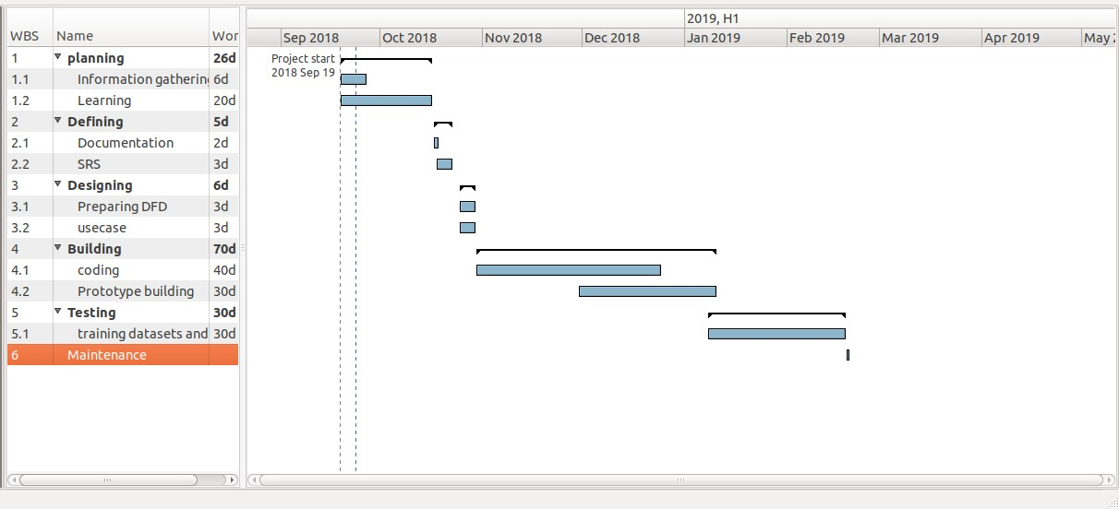
PROJECT PLAN (GANTT CHART)

Slide 13
SUMMARY
◆ The prototype will aim at automating the basic appliances like one of each ACs, fans, lights and PCs.
◆ The result we wish to achieve, if the prototype shows optimal performance, is to automate the complete lab.
◆ The system will facilitate the user with much more control over their ambience.

Slide 14
REFERENCE
◆ Towards the Implementation of IoT for Environmental Condition Monitoring in Homes-Sean Dieter Tebje Kelly, Nagender Kumar Suryadevara, and Subhas Chandra Mukhopadhyay, Fellow, IEEE, IEEE SENSORS JOURNAL, VOL. 13, NO. 10, OCTOBER 2013
◆ Smart Home and Smart City Solutions enabled by 5G, IoT, AAIand CoT ServicesK E Skouby, P Lynggaard - 2014 International Conference on
Contemporary Computing and Informatics (IC3I)
◆ Mobile based Home Automation using Internet of Things(IoT) Kumar Mandula, Ramu Parupalli, CH.A.S.Murty, E.Magesh, Rutul Lunagariya - 2015 International Conference on Control,lnstrumentation, Communication and Computational Technologies (lCCICCT)
◆ A Remote Sensor Network using Android Things and Cloud Computing for the Food Reserve Agency in Zambia –Mulima Chibuye, Jackson Phiri (IJACSA) International Journal of Advanced Computer Science and Applications, Vol. 8, No. 11, 2017
◆ Implementation of Voice Based Home Automation System Using Raspberry Pi -Harshada Rajput1, Karuna Sawant2, Dipika Shetty3, Punit Shukla4, Prof. Amit Chougule5 International Research Journal of Engineering and Technology (IRJET) e-ISSN: 2395-0056 Volume: 05 Issue: 05 | May-2018
◆ Intelligent smart home energy efficiency model using artificial TensorFlow engine Jo and Yoon Hum. Cent. Comput. Inf. Sci. (2018) 8:9
◆ IoT Based Home Automation System over the CloudMs. Fareha Firdous, Ms. Sumayya, Mr. Aseem Mohd Umair International Journal of Innovations & Advancement in Computer Science IJIACS ISSN 2347 – 8616 Volume 7, Issue 3 March 2018
◆ IoT based Smart Home Automation System using Sensor Node Himanshu Singh , Vishal Pallagani†, Vedant Khandelwal‡ and Venkanna U.§ 4th Int’l Conf. on Recent Advances in Information Technology | RAIT-2018 |
◆ Gesture Control for Home Automation Using Internet of Things Sunil Kumar Khatri, Govind Sharma, Prashant Johriand Sachit Mohan © Springer Nature Singapore Pte Ltd. 2018 S. Bhalla et al. (eds.), Intelligent Computing and Information and Communication,Advances in Intelligent Systems and Computing 673
◆ Smart Home Automation System Using Bluetooth Technology Muhammad Asadullah, IEEE Student Member, Khalil Ullah 978-1-5090-3310-2/
17/$3\.00 ©2017 IEEE

